Slide 1
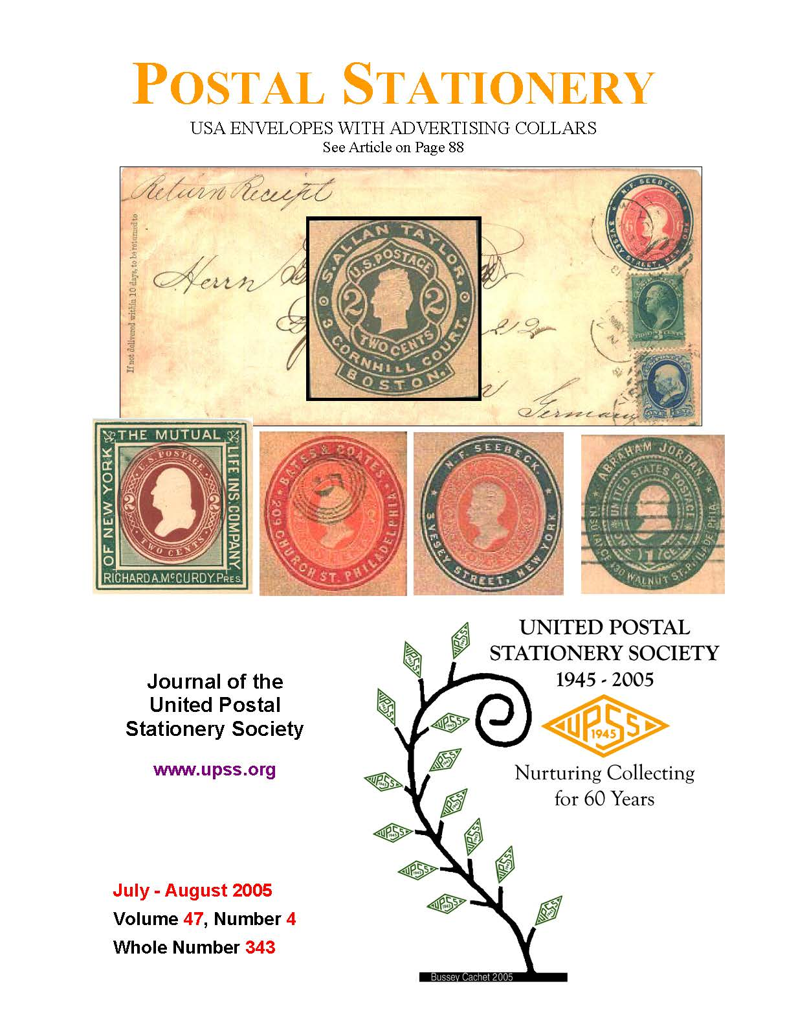
United Postal Stationery Society
Introduction to U.S. Postal Stationery

Slide 2
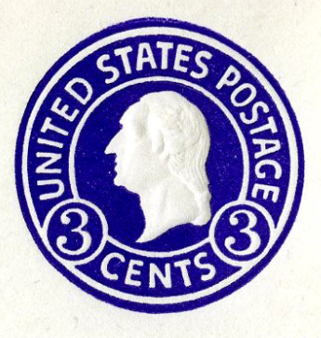
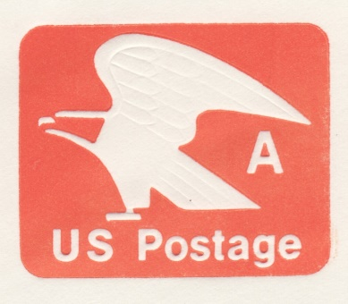
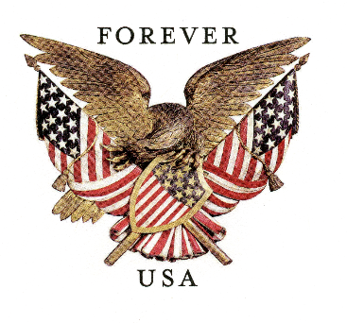
Postal Stationery is
postal matter which has either an
officially authorized pre-printed stamp or
inscription indicating that a specific face value of postage or related service has been prepaid“
Envelopes with these stamps are all considered Postal Stationery since a specific face value of postage has been prepaid.
Notes:
Items may be embossed or not. They may have a stated value or not, but must have been released for a specific value, e.g. the ‘A’ stamp had (and still has) a value of 15¢ and the forever stamps have a value of the current 1st class postal rate.

Slide 3
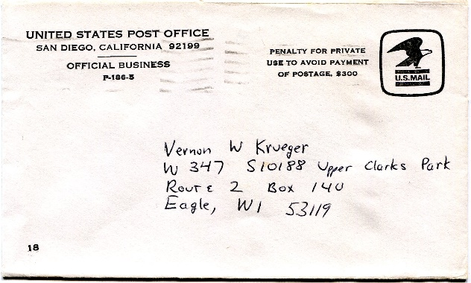
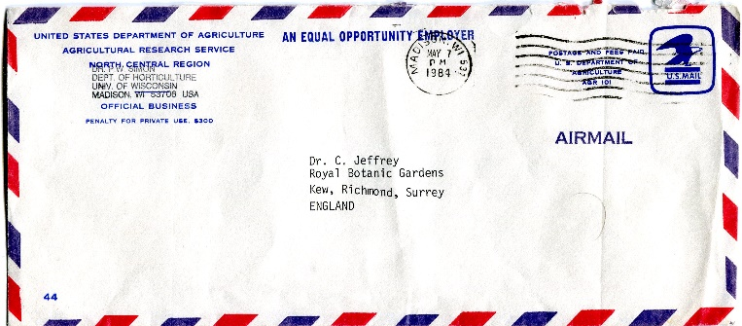
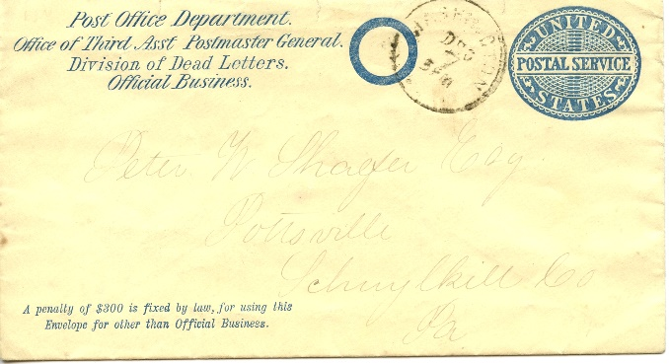
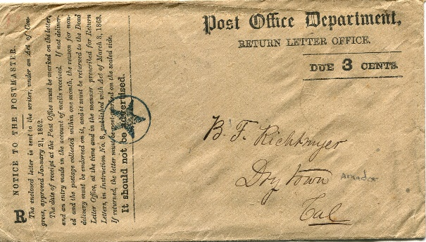
Postal Stationery is
postal matter which has either an
officially authorized pre-printed stamp or
inscription indicating that a specific face value of postage or related service has been prepaid“
These envelopes do not have a stamp with specific face value and are not considered to be postal stationery (even though the official postal service envelope at lower left is listed in many catalogs).
Notes:
Scott UO14 to UO17 have been listed in many catalogs but are technically not postal stationery since no value is stated. The same is true for envelopes with ‘Penalty for private use’ printed in the upper right corner or elsewhere.

Slide 4
Introduction
The earliest items of U.S. postal stationery were envelopes.
The other forms of U.S. postal stationery include:
  wrappers (newspaper bands),
  postcards,
  letter cards, and
  air letter sheets (aerograms)
Other types of documents (such as registration envelopes and certificates of posting) bearing impressions of postage stamp designs have been produced by other countries.
Notes:
Envelopes were not commonly used until postal agencies stopped charging by the sheet (where the envelope counted as a sheet) and switched to charging by weight which occurred in most countries in the mid 1800’s.

Slide 5
Introduction to U.S. Envelopes
The first American envelope was developed in 1839.
  Until 1847, postage was charged by the number of sheets as well as the distance to be traveled. Thus use of an envelope doubled postage. This and paper shortages caused few envelopes to be used.
The first U.S. Postal envelope was produced in 1853.
Postal Stationery collecting encompasses the indicia (stamp) as well as the differing envelopes on which the stamp appears.
  attributes necessary to identify the envelope include size, knife, paper type, gum type, watermark and recycle logo.
Notes:
Knife is the size and shape of the envelope blank with flaps. In the 1800’s envelopes were cut by cookie cutter form (knife) and this switched to cutting on the web press from a paper roll in the 1900’s.
The first U.S. postal envelope was produced by George Nesbitt. All U.S. postal stationery has been produced by contract with private companies, unlike currency or stamps at some periods. Many other countries produced postal stationery in government printing facilities.

Slide 6
Envelope Size
About 25 sizes of U.S. stamped envelopes have been produced. The Postal Service now uses 3 basic sizes for modern envelopes –
6¾ - 165 mm by 92 mm UPSS size 12
9 – 225 by 98 mm UPSS size 21
10 – 241 by 105 mm UPSS size 23
The UPSS has established a unique number for each size to allow comparison historically when the Post Office changed size designations.
Notes:
Generally envelope sizes were denoted by numbers but for a time in the 1890’s the Post Office used letters A to R to identify envelope sizes. The UPSS gives a size number (e.g. size 12 for U. S. Post Office designation 6¾) because the Post size designations have changed over time for the same envelope size.

Slide 7
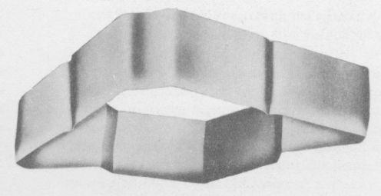
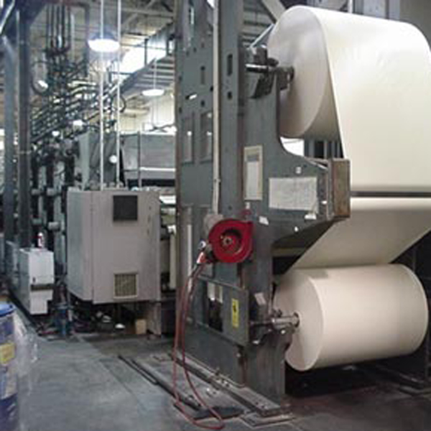
Envelope Knife
Knife is the overall shape of the envelope prior to folding.
Originally, the knife was a cookie cutter type mold used to cut the actual blank envelope shape. The knife would be laid on a pile of sheets and cut around with a sharp knife in early years or pushed through the paper with a hydraulic press in later years.
Now envelopes are cut from paper rolls by rotary knives. However, the term is still used to refer to the shape prior to folding.
Notes:
There are over 120 knives of U.S. envelopes.

Slide 8
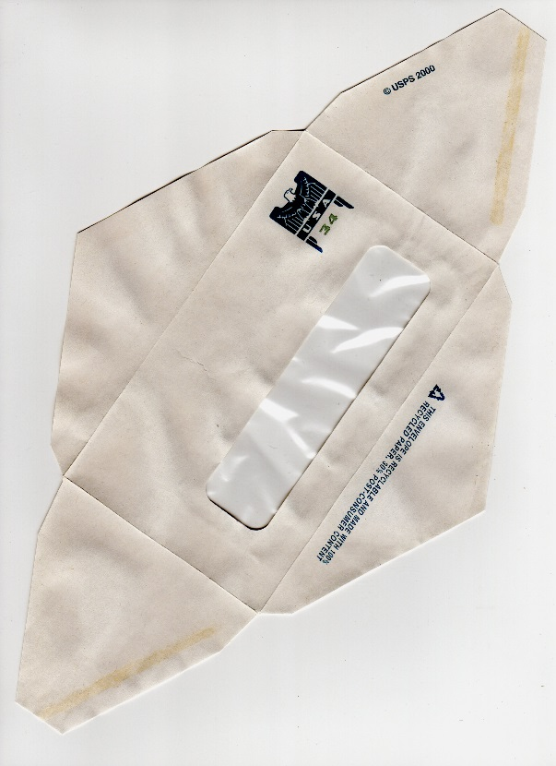
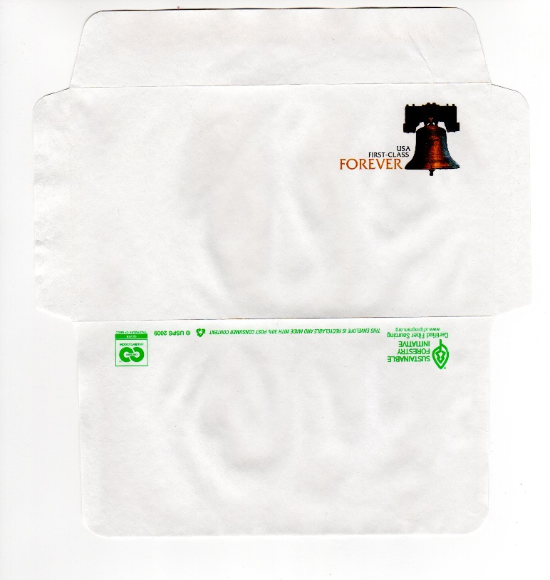
Modern Envelope Knives
Top Flap
Left Flap
Right Flap
Bottom Flap
Left Flap
Knife 70
(plain front)
Knife 69
(with window)
Notes:
Envelopes are composed of the front, top flap, right and left flaps. They may additionally have a window.

Slide 9
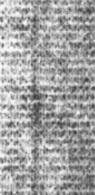
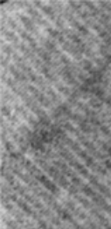
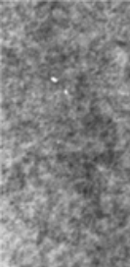
Envelope Paper
Two basic types of paper – Laid and Wove – have been used to U.S. produce envelopes.
Paper is manufactured by placing a paper mash thinly on a woven wire mesh. Water is removed and the paper is dried.
Laid paper shows a watermark of parallel lines close together when held to a light. The lines may either be horizontal, vertical or diagonally.
Horizontally Laid
Diagonally Laid
Wove paper is similarly produced however the wires of the mesh are interwoven much like a screen. This paper has a mottled appearance and was produced as both standard or extra quality paper which can be differentiated by either weight or thickness.
Wove Paper
Notes:
Envelopes were produced on laid paper in the 1800’s and early 1900’s. The change to wove paper occurred during the Mercantile issue (1915-1916). Thus the mercantile issue occurs on both paper types. Earlier envelopes on wove paper are errors that are worth significant amounts.

Slide 10
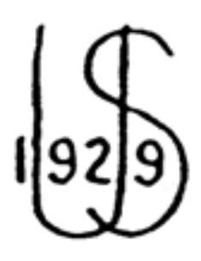


Watermarks
Watermarks are impressions made when paper is manufactured as a security device and are visible as lighter areas when paper is held to a light.
Watermarks were produced by soldering bent wires onto a mesh cylinder. Then the paper mash was applied and the raised areas of the cylinder transferred to the paper as thinner areas.
Watermark designs changed with each new envelope contract in the U.S. until 1961.
Use of watermarked paper ceased with the introduction of recycled paper in the 1990s.
Watermark 30
Watermark 48
Watermark 51
Notes:
Watermarks were considered a security device (to keep individuals from counterfeiting U.S. postal stationery envelopes.

Slide 11
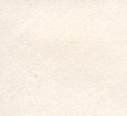
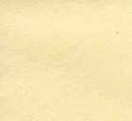
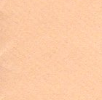
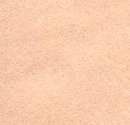
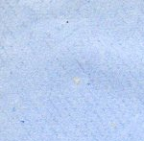
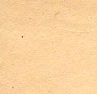
Paper Color
Envelope paper colors varied throughout production. They include white, amber, oriental buff, fawn, blue and manila. Manila is a paper type more than a color, is cheap and of low quality.
White
Amber
Oriental Buff
Fawn
A color chart is shown on the next slide that can assist in the identification of the various envelopes used with the different colored paper.
Blue
Manila
Notes:
Most countries only produced envelopes on one or two paper types. The U.S. Postal Contracts called for as many as 5 different paper types at some times.

Slide 12
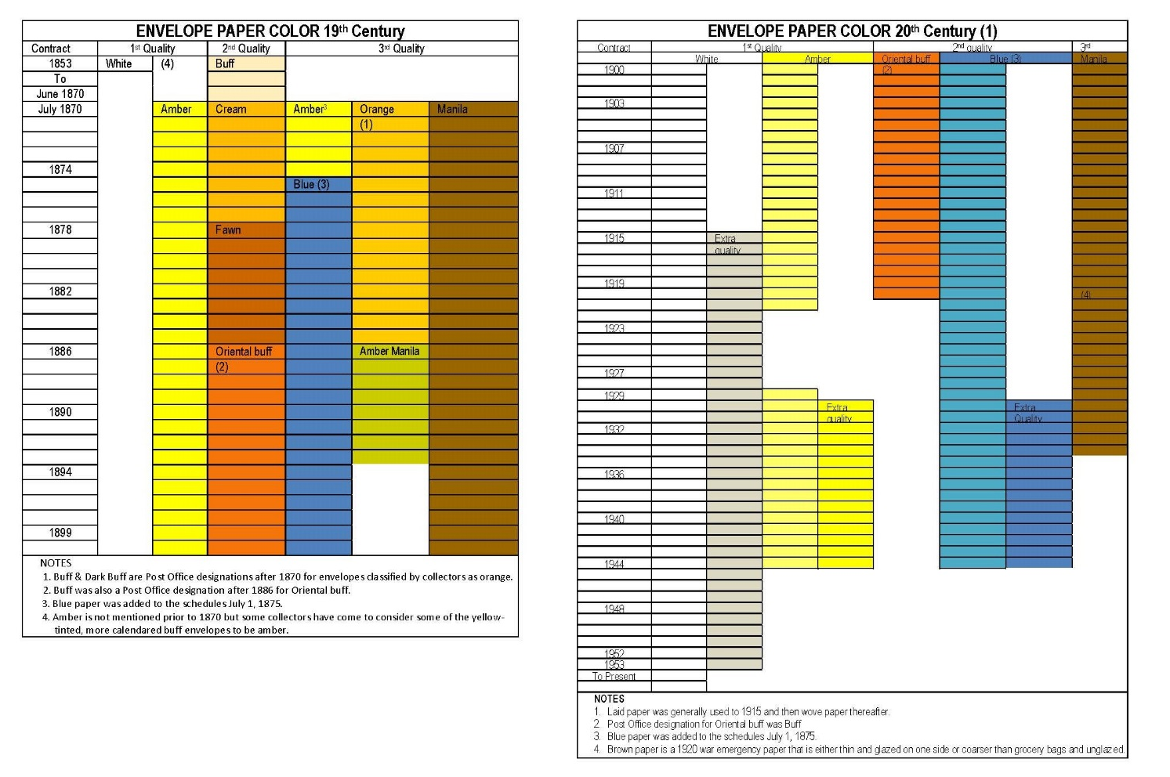
Paper Color Chart
Notes:
A paper color chart is included in the two United Postal Stationery envelope catalogs available at www.upss.org.

Slide 13
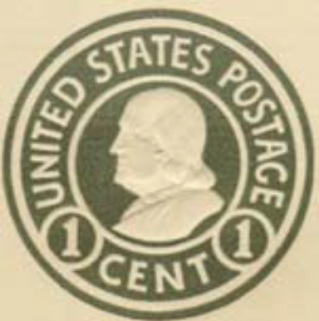
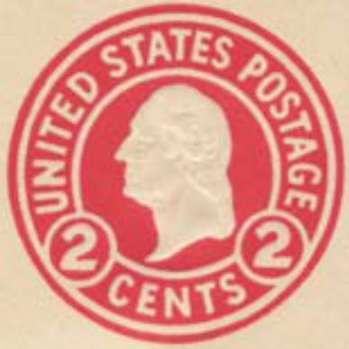
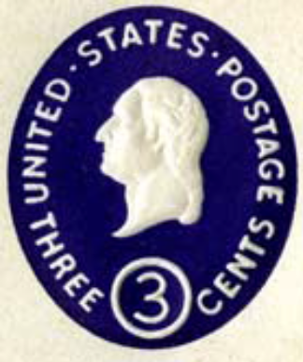
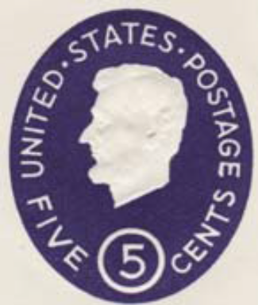
Embossed Envelope Dies
Dies are used to create the impressions on the envelope. They are hand engraved in reverse on a steel block. These Master dies are hardened and then used to produce Hub dies which in turn are used to make the working dies used during production of the envelopes.
Although the images that appear on modern envelopes are still referred to as dies, modern envelopes no longer are printed from embossed dies. Since the 1970’s stamps have been largely surface printed on envelopes
Notes:
Die types are defined in the United Postal Stationery envelope catalogs, along with a chart for easy identification.

Slide 14

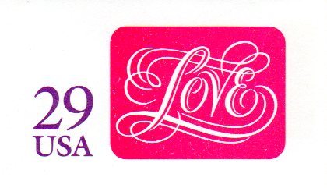

Surface Printed Dies
Lithography
Lithography uses chemical processes to create an image. For instance, the positive part of an image is a water-repelling substance, while the negative image is water-retaining.
Thus, ink will adhere to the positive image and be transferred to the paper.
Notes:
the positive part of an image is a water-repelling (“hydrophobic") substance, while the negative image is water-retaining (“hydrophilic").

Slide 15
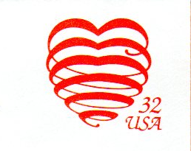
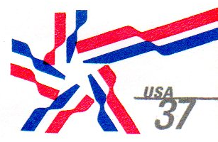

Surface Printed Dies
Topographic printing is the exact opposite of engraved printing. The ink for the stamped area is applied directly to the raised portion of a plate for transfer to the envelope.

Slide 16

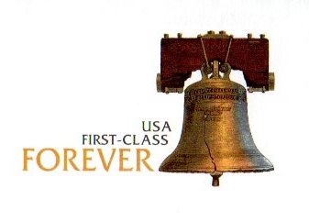
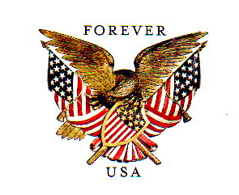
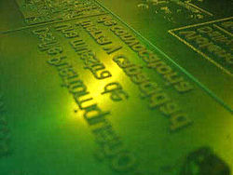
Surface Printed Dies
Flexographic printing is a form of rotary web letterpress, combining features of both letterpress and rotogravure printing, using relief plates of flexible rubber or photopolymer and a fast drying, low viscosity solvent, water-based or UV curable inks.
Flexographic Plate

Slide 17
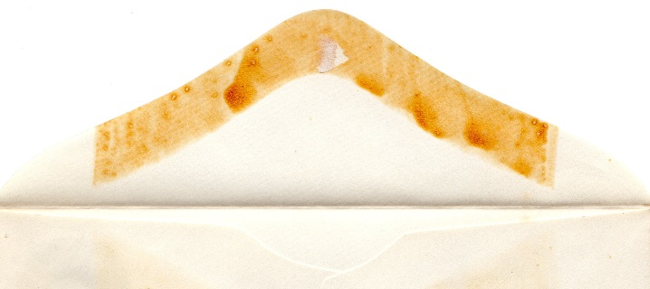
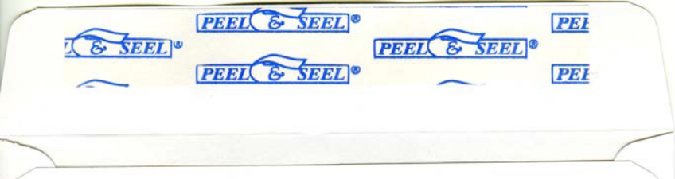
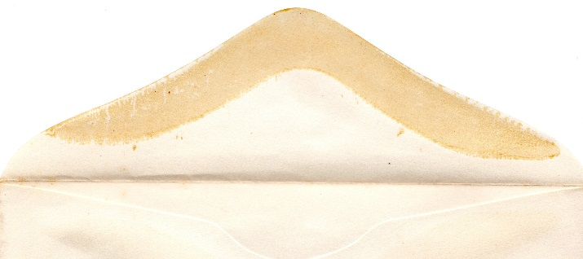
Gum (Adhesive)
Gum is used to keep the envelope together by adhering the side and bottom flaps to one other while the gum on the top flap remains un-adhered to allow the user to seal the envelope after the contents have been inserted.
Originally, gum was applied by hand until the equipment to do it mechanically was developed. Currently, two basic types of gum are used – water activated which requires adding moisture and pressure sensitive which only requires a peel and press operation.
Hand Gummed (Square Gum)
Machine Gummed (Round)
Pressure Sensitive Adhesive Peel Strip
Notes:
Hand applied gum has square ends because several envelopes were overlayed with just half an inch of top flap exposed and then the person doing the gumming ran a roller across the envelopes to gum the top flap.

Slide 18




Early Recycle Logos
In an effort to exhibit a more environmentally friendly awareness, the Postal Service required that envelope paper contain varying amounts of recycled paper along with the virgin fiber. To reflect this commitment, recycle logos with various text and compliance symbols are depicted on the envelopes. There are 21 different logos. Examples of some are shown below.
Recycle Logo E
Recycle Logo A
Recycle Logo C
Recycle Logo I
Notes:
A full listing of the logos is in the appendix of the UPSS Catalog of the 20th and 21st Century Envelopes and wrappers of the United States.

Slide 19




Modern Recycle Logos
The Sustainable Forest Initiative (SFI) emblem was added to the logo in May, 2009.
In January, 2010, the Cradle to Cradle (CTC) emblem was added to the right of the SFI emblem.
Another change occurred in January, 2011 when the CTC emblem was moved to the far right of the entire logo string.
Recycle Logo J
Recycle Logo L
Recycle Logo M
Then in June, 2012 the CTC emblem was found to be missing from the logo altogether.
In January 2015, a new certification was used from the Forestry Stewardship Council replacing the SFI emblem. This change occurred due to a change in the paper supplier
Recycle Logo O
Recycle Logo U

Slide 20
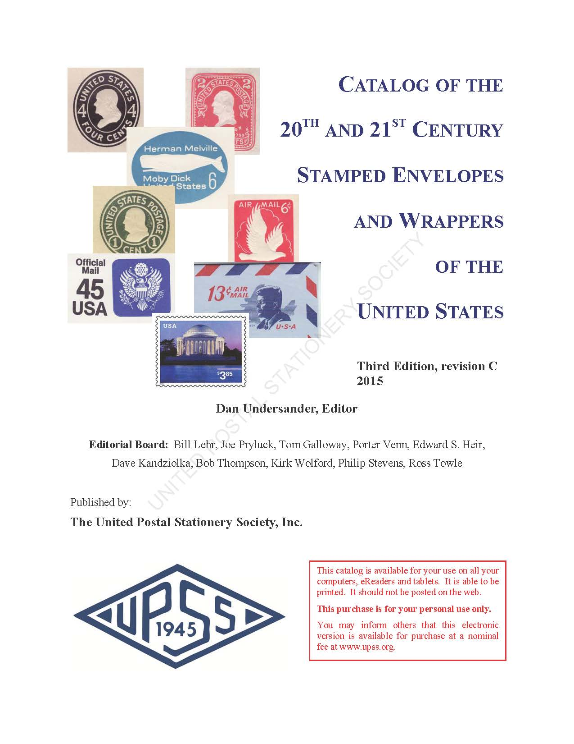
United Postal Stationery Society catalogs are a one source reference for all postal stationery listings including illustrations, prices, knives, logos and more.
Begin your collecting experience by obtaining a catalog now and joining the United Postal Stationery Society today!
What may look like an everyday item could be something more valuable than imagined!
Order printed or electronic books from the Society website at:
www.upss.org

